Slide 1
Seismic Detection,Visualisation and Analysis
GUIDED BY: PREPARED BY:
PROF . JOSMY GEORGE JUSTINE BIJU PAUL
DEPARTMENT OF COMPUTER SCIENCE AND BIJIN BINOY
ENGINEERING NISSA ANN SAJI
ALLAN SHIBU KOSHY

Slide 2
CONTENTS
Literature Survey 3:
> Paper 1: General Overview,Limitations,Adavantage
> Paper 2: General Overview,Limitations,Adavantage
Project Progress
Demo
Conclusion

Slide 3
LITERATURE SURVEY - 3

Slide 4
Paper 1: LEQNet:Light Earthquake Deep Neural Network for Earthquake Detection and Phase Picking
Authors: Jongseong Lim, Jin Kyu Gahm and Giltae Song, Frontiers, Published in 2022
LEQNet: Lightweight deep neural network for seismic detection and phase picking in on-site EEW systems.
Uses recursive structures, bottleneck layers, and depthwise separable convolutions to cut size and computation.
88% smaller than EQTransformer (from 4.5 MB to 0.94 MB) with similar accuracy (F1-scores: 0.99, 0.98, 0.97).
Runs efficiently on low-cost IoT sensors, reducing dependence on servers or high-end hardware.

Slide 5
Limitations
Optimized for small devices.
Low memory usage(<256kb).
Regional Database is used.
Advantages Compared to our project
For all types of devices.
For each Data different memory is used.
Data from around the world.

Slide 6
Paper 2: Seismic arrival-time picking on distributed acoustic sensing data using semi-supervised learning
Authors: Zachary E. Ross, Ettore Biondi ,JiaxuanLi,Jiuxun Yin, Nature Communications, Published in 2023
PhaseNet-DAS: Deep learning model for DAS seismic data, processing 2D spatio-temporal inputs to detect earthquakes and pick P/S phases.
Uses semi-supervised learning with pseudo labels from a pre-trained PhaseNet and phase association to overcome limited manual labels.
Shows high accuracy and robustness in noisy DAS environments, improving detection of low-SNR events and supporting real-time monitoring and tomography.

Slide 7
Limitations
Region biases may be present.
Advantages Compared to our project
No bias for any regions.

Slide 8
Project Progress
The dashboard currently receives and preprocesses waveform data from uploaded seismic recordings and edge sensors.
Model training pipelines (LEQNet-Pro, Efficient-CNN-v2, and LSTM-Classifier) are implemented and running efficiently within Kaggle/Colab GPU constraints.
Evaluation reports, confusion matrices, and TFLite conversion are successfully generated, and model performance meets initial PRD goals for accuracy and F1 score.
The next steps include enabling live waveform streaming through ObsPy, adding real-time classification and alert APIs, and integrating the EEW dashboard for visualization of detected events and epicenter localization.

Slide 9
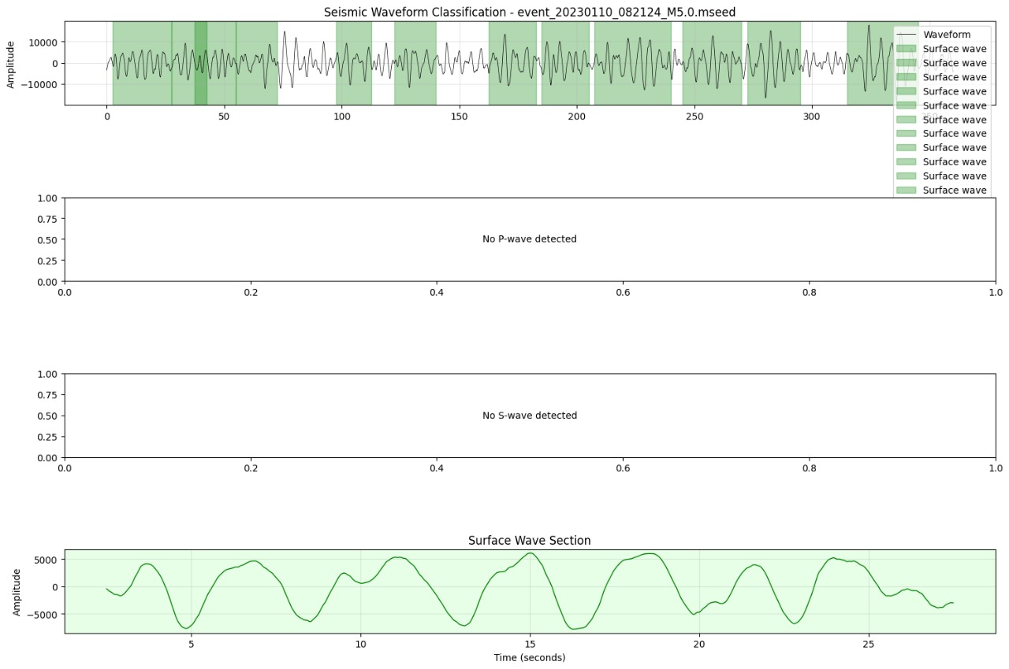
DEMO of our Project
Fig 1: Represent Testing phase of our model

Slide 10
General Conclusion
Most reviewed papers share common limitations like region biases, noise sensitivity, and limited generalization across regions.
These studies highlight the need for a more adaptable and unified seismic detection approach.
Our project aims to overcome these recurring challenges by improving accuracy, robustness, and scalability.
By integrating insights from all 15 papers, we are developing a comprehensive system that addresses existing gaps in seismic detection and analysis.

Slide 11
THANK YOU

